Slide 1

Black Olive Concepts proudly presents:
™
™
™

Slide 2
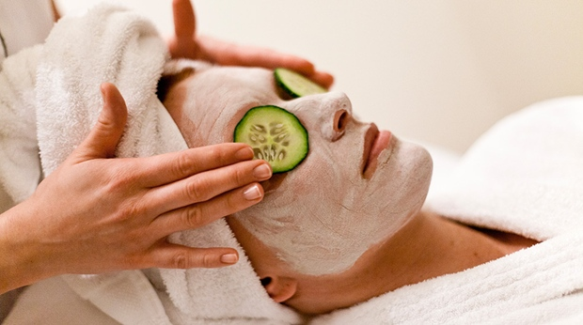


Mission Statement
Evolv's mission is to offer on-demand premier spa and salon services at a customer’s preferred location through a simple mobile procurement platform.

Slide 3
Restaurant Concepts
Concept (Menu)
Process
Service
Quality
Physical Facilities
Figure 10.1 Aspects Involved in Menu Concepts

Slide 4
Successful Restaurant Concepts for Franchising
Simplicity
Replication Capability
Ready Availability
Quality
Serviceability
Fig 10.2 Components of a Successful Menu Concept

Slide 5
Food Characteristics
Color
Texture and Shape
Consistency
Flavor
Preparation Method
Serving Temperature
Presentation
Nutritional quality
Food Preference
Packaging and Delivery
Cost-Effectiveness
RECIPE TESTING AND STANDARDIZATION
Recipes that are tested for quality Recipes that are tested for quality, quantity, procedures, time, temperature, equipment, and yield are called standardized recipes.

Slide 6
Layout and Physical Facilities
Receiving Area
Storage Areas
Dry Storage Areas
Refrigerated Storage Areas
Frozen Storage Areas
Sanitation Area

Slide 7
Layout and Physical Facilities
Equipment Selection and Layout
Need and Cost
Functional Attributes
Sanitation and Safety
Size, Appearance, and Design
Overall Performance

Slide 8
Layout and Physical Facilities
Planning the Overall Atmosphere
Appearance
Color, Odor, Sound, comfort
Service
Marketability
Management

Slide 9
Site Selection and Real Estate

Slide 10
Value proposition & strategy
VALUE PROPOSITION
STRATEGY
Broad range of on-demand premier spa and salon offerings
Prompt, onsite, and professional services offered in the safety, comfort, and convenience of your preferred location
Simple and secure order and payment platform
Develop Application
Recruit service providers
Target initial customer base

Slide 11


Target customers & SEGMENTATION

Slide 12
Marketing Mix & Differential Advantages
The 7Ps for Services
  Product, place, performance, process, people, promotion, and price
Offering more services, more conveniently, and more effectively than anyone else in the market today

Slide 13
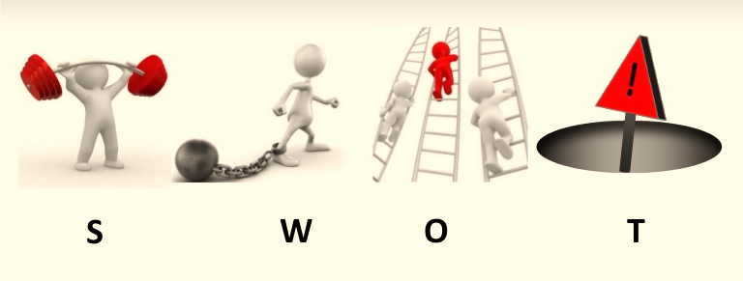
Market analysis: SWOT Analysis
Environment > Industry > Business

Slide 14
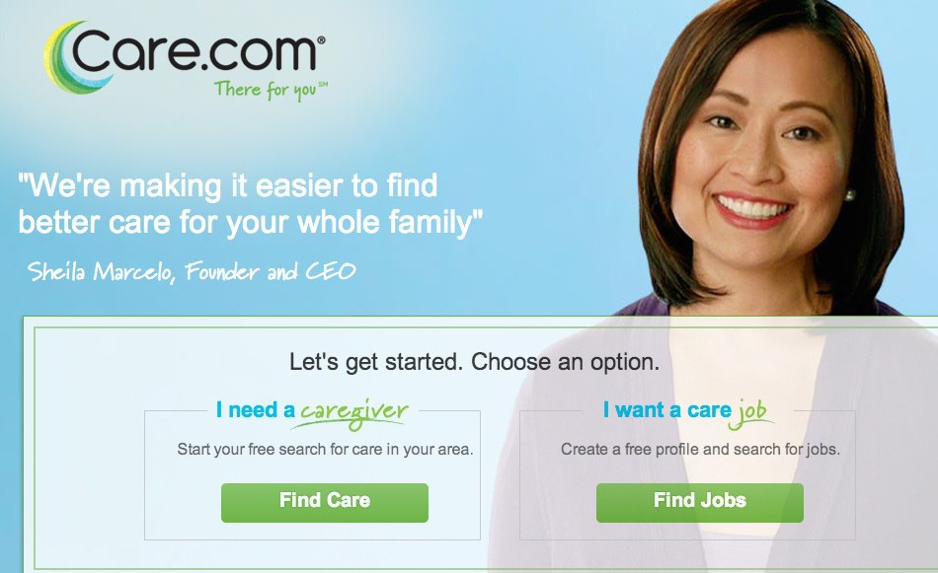

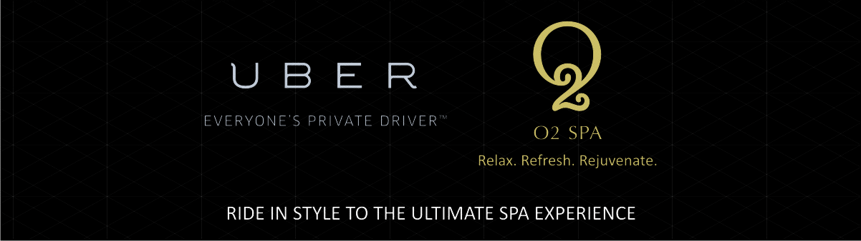



Competitor analysis

Slide 15
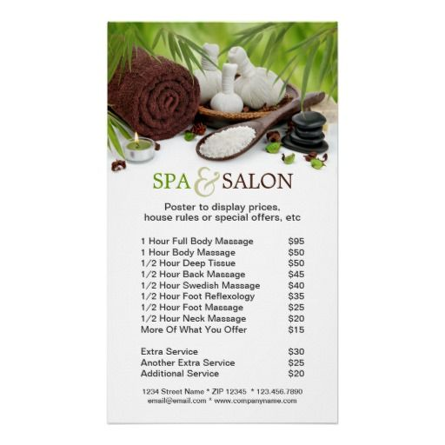




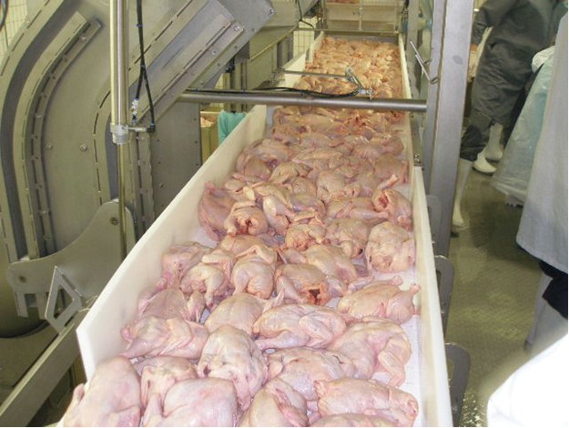
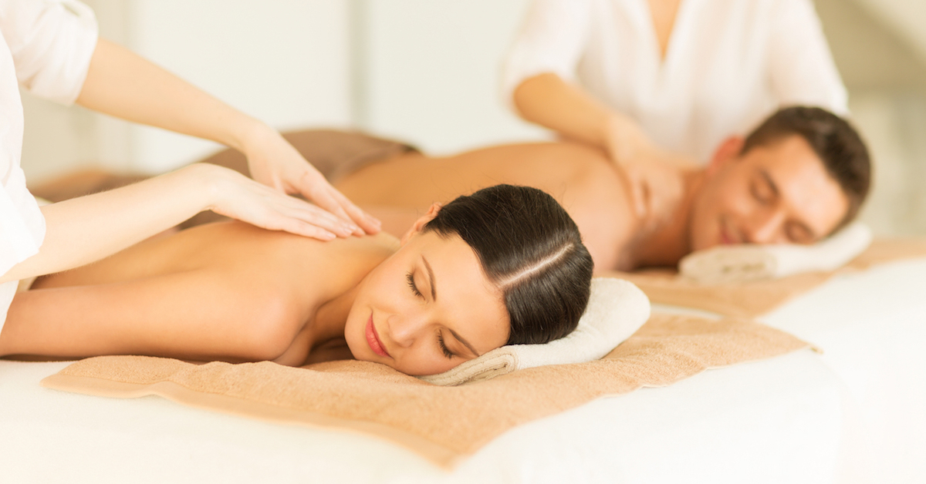

Process imagery
Notes:
Download app or get on website and order one of our services

Slide 16
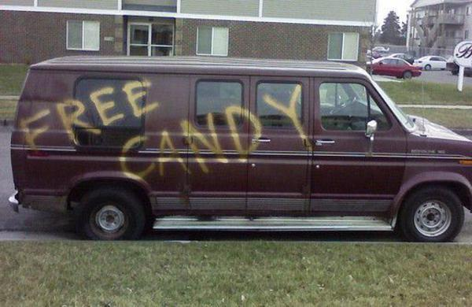
recruiting FRANCHISEES

Slide 17
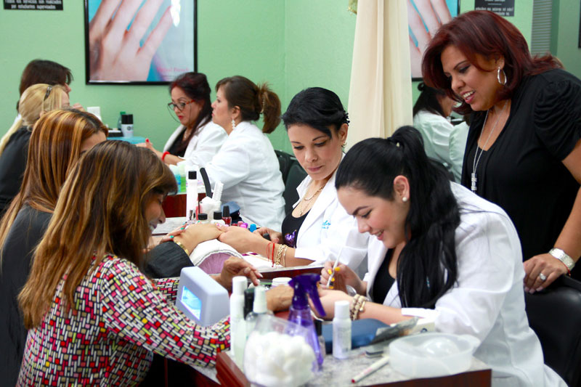

recruiting service providers

Slide 18
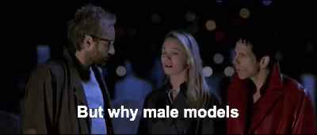
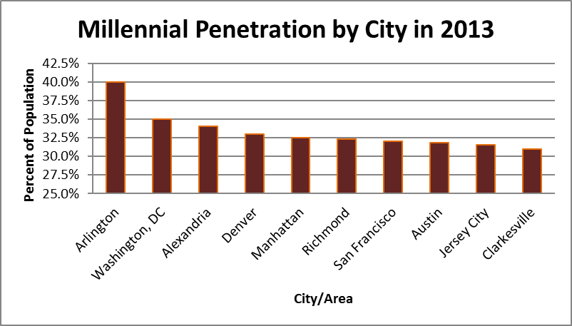
Customer Segments
Millennials
Gg
They have money
They are tech savvy
They like on-demand
DC Metro Area
Lots of Millennials
Low car ownership
Fertile recruiting ground

Slide 19

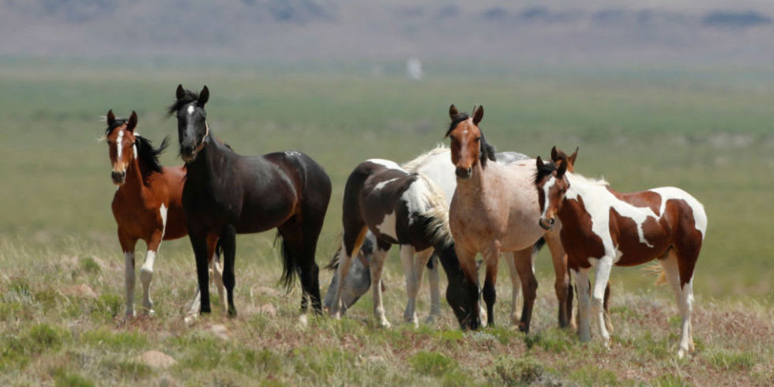
Marketing Strategy – The Message
Evolv
We offer what nobody else offers
More services
More convenience
Quicker
Premier providers
Traditional Spas and Salons

Slide 20

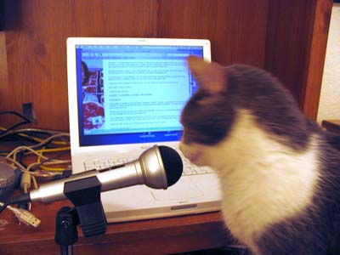
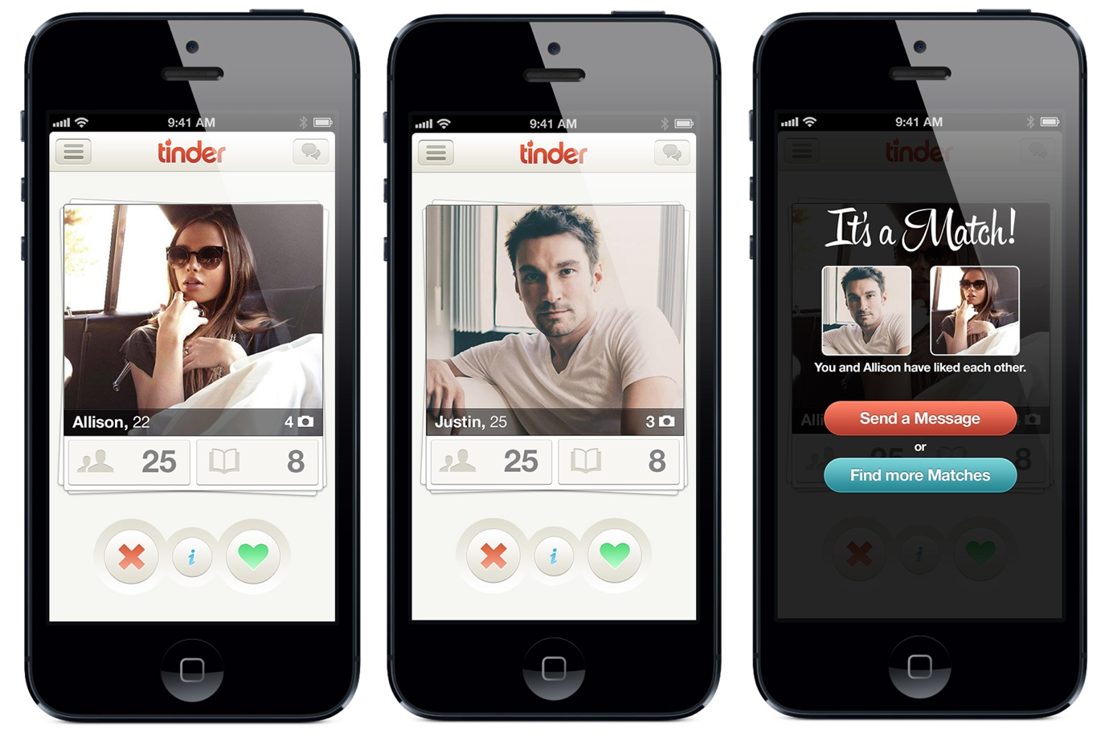
Marketing Strategy – Ad Channels

Slide 21
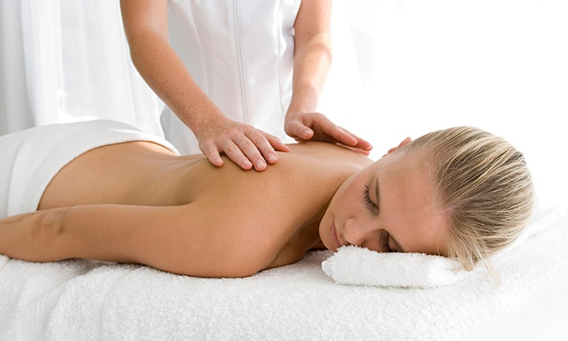


Marketing Strategy - Promotion
10
10% Off

Slide 22
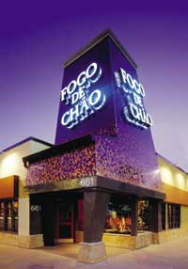
prototype

Slide 23
FRANCHISE FEES/ALL OTHER FEES WITH CONDITIONS

Slide 24
SERVICES TO BE PROVIDED TO THE FRANCHISEES

Slide 25
EXPANSION PLAN

Slide 26
conclusion
There is a need for Evolv
Evolv offers something completely unique
Millennials = Customer : Millennials = Plentiful : Customers = Plentiful
Evolv’s business model = low fixed cost, low labor cost, high profit potential
Evolv can grow

